Slide 1
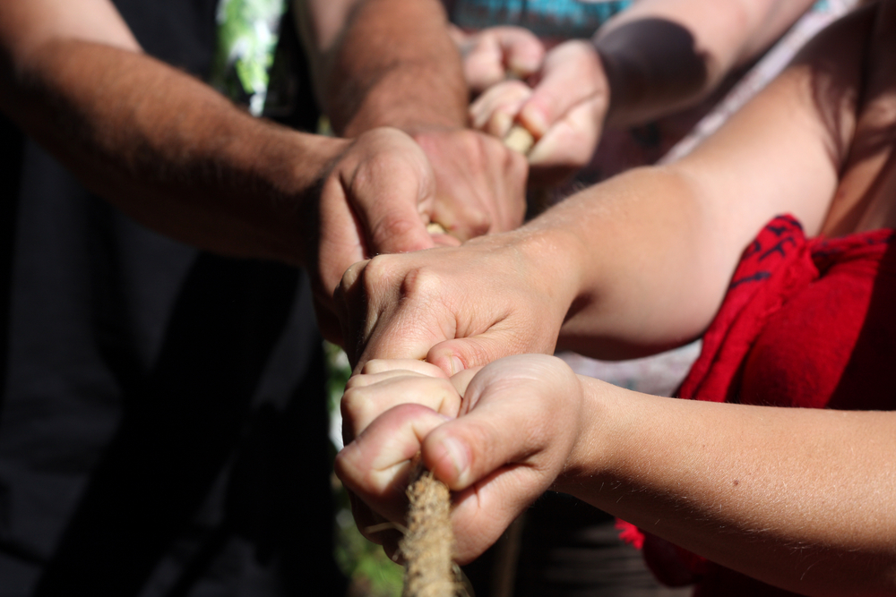
Data Management Training Clearinghouse
Welcome and Introductions
Image from Shutterstock

Slide 2
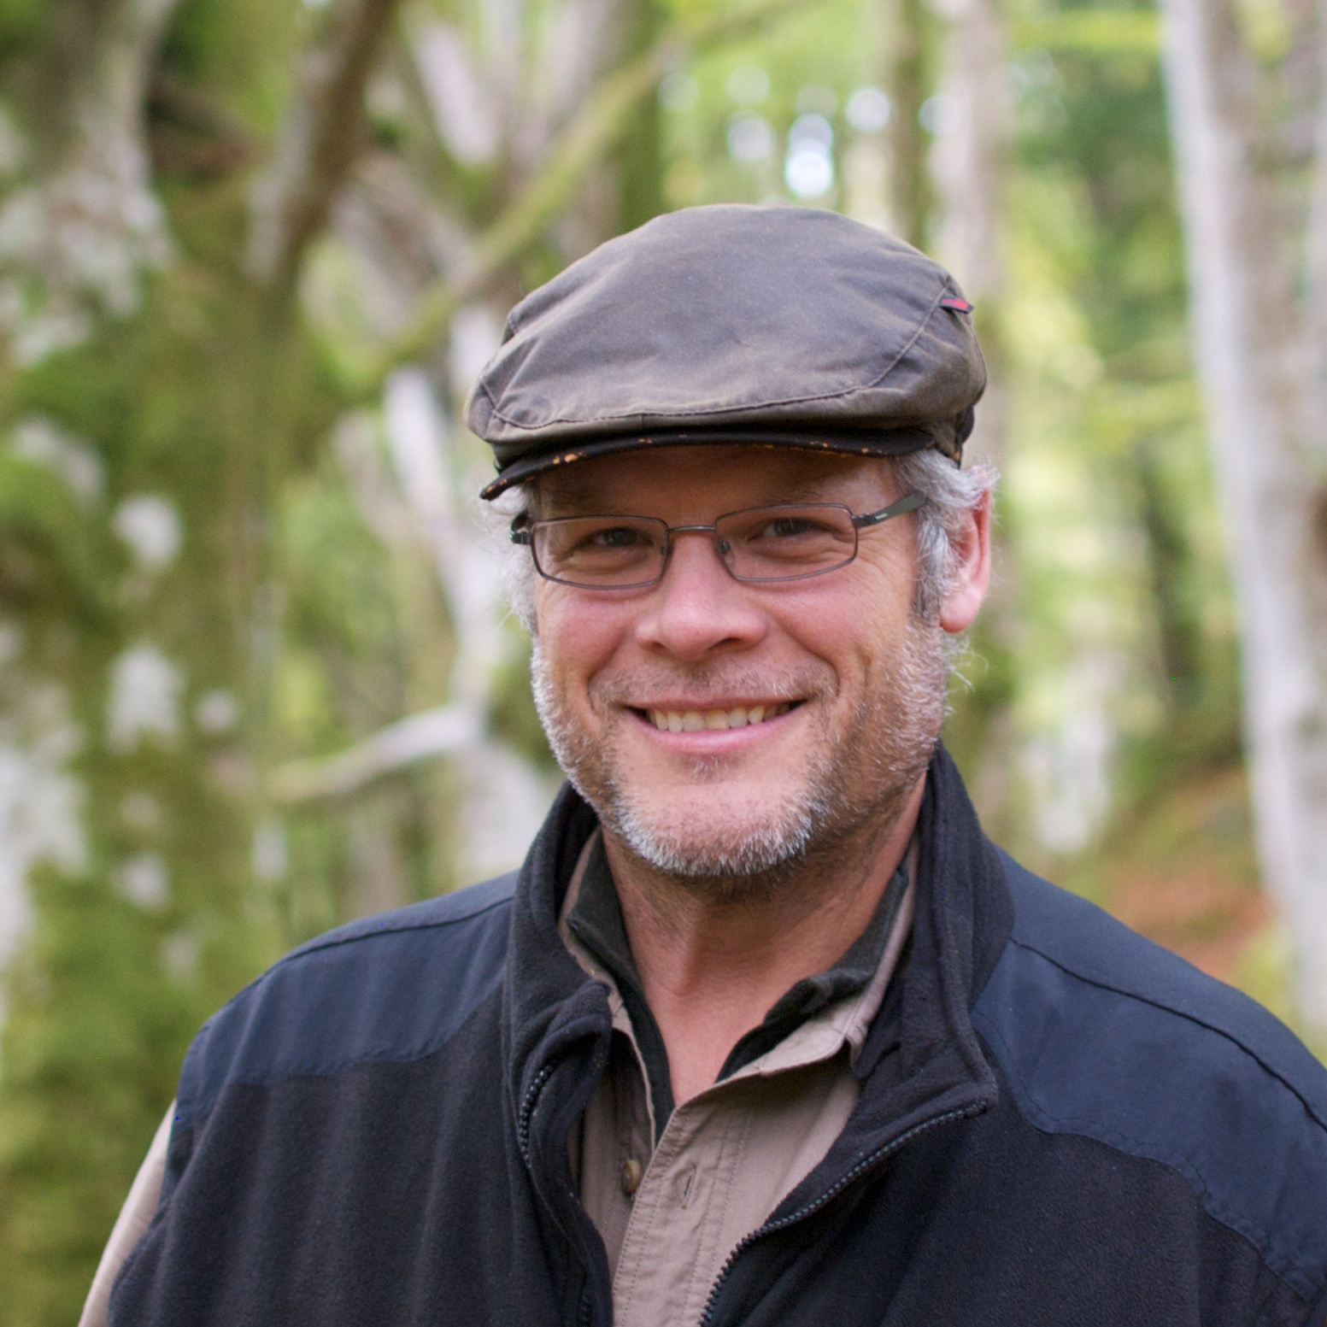
Introductions – Who are We? Who are You?
Sophie
Hou
Nancy
Hoebelheinrich
Karl
Benedict

Slide 3

Please tell us a bit about yourself
Photo Credit: J J (http://tinyurl.com/ood3en5) - CC:by-nc-nd
Your Name
Affiliation
Role in Research in Your Organization
One Thing You Would Like to Get out of the Workshop

Slide 4



Thank You
Karl Benedict, Nancy Hoebelheinrich, Sophie Hou
http://dmtclearinghouse.esipfed.org/

Slide 5

Data Management Training Clearinghouse
Background, Workshop Goals and Objectives
Image from Shutterstock

Slide 6
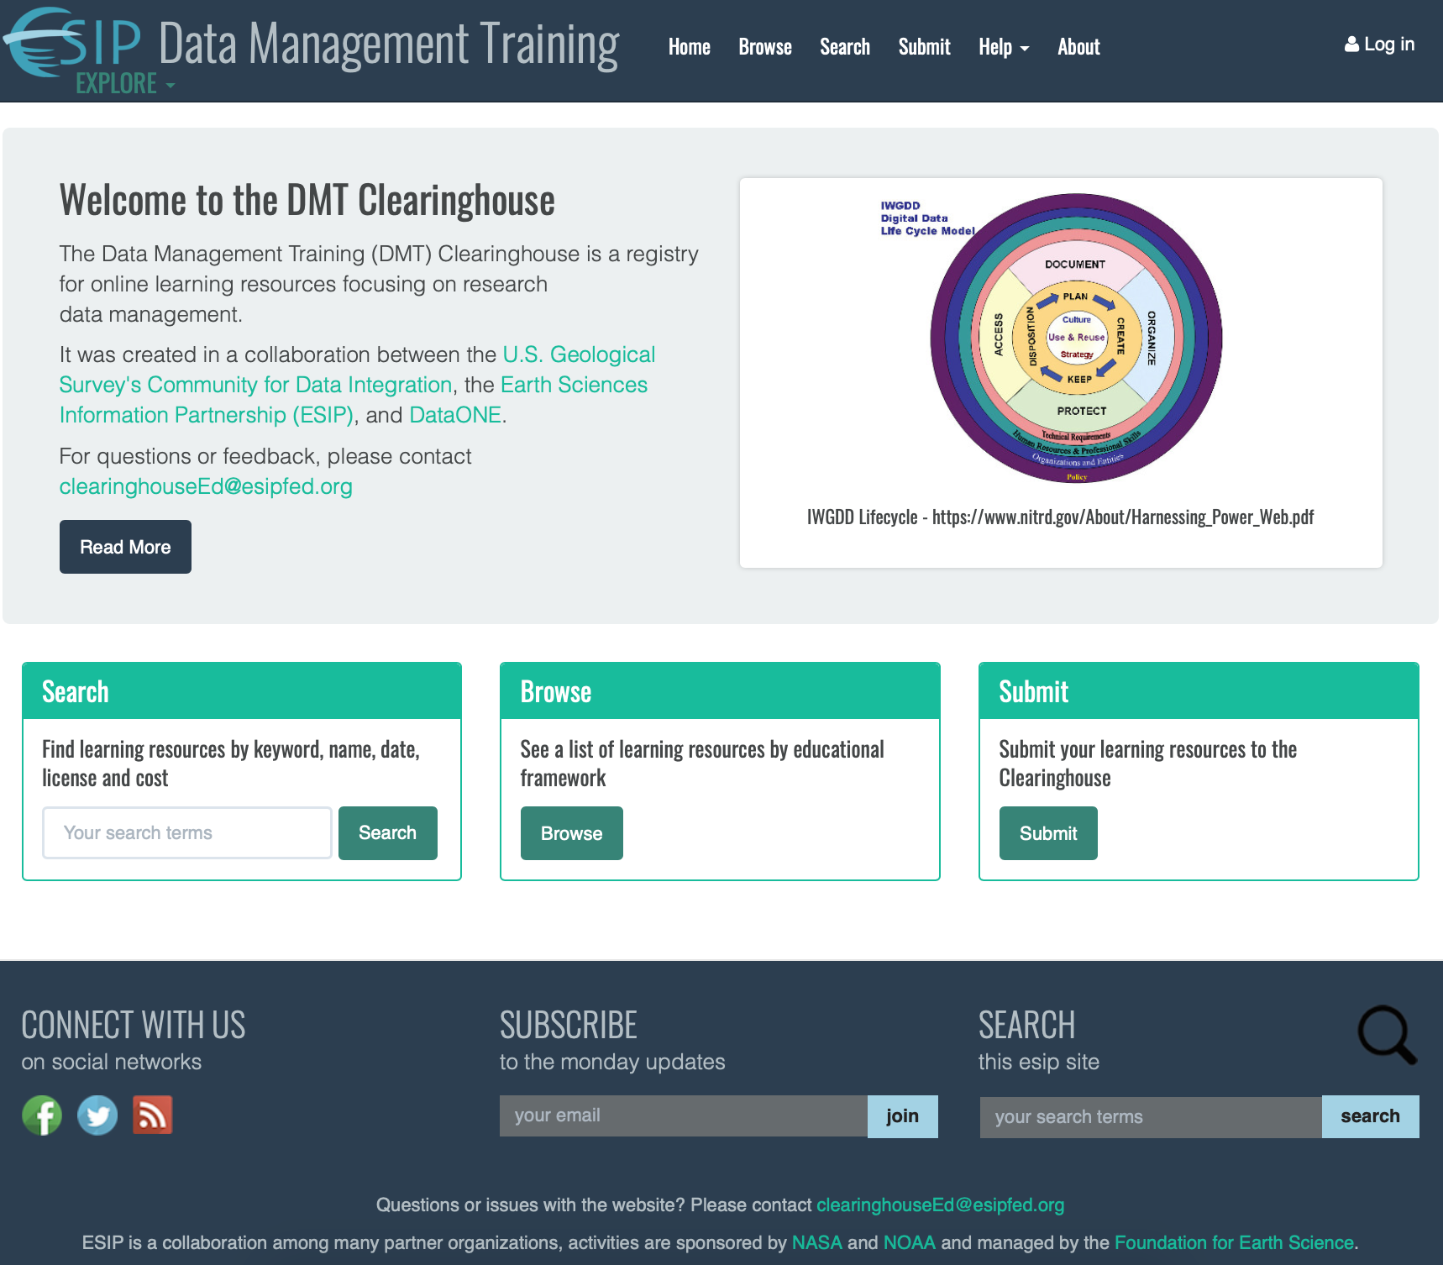
Data Management Training Clearinghouse Background
Work Started 2015
First Content in 2016
Funded by USGS, DataONE, and the Earth Science Information Partners (ESIP)

Slide 7
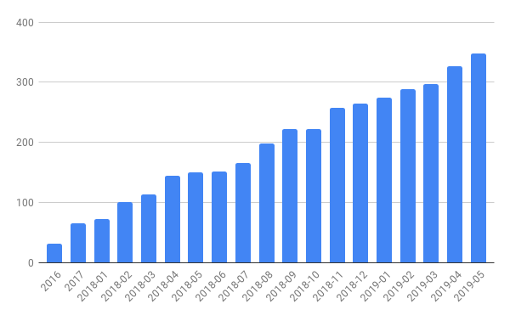
Continued Development Supported by IMLS
Number of Training Resources in the DMTC
Original development
IMLS Project (continuing)
July 2018 – Start of 3 year project to enhance the DMTC
Metadata/Search
Assessment
Diversity of Content
Quantity of Content

Slide 8

Today’s Goals and Objectives
Increase the visibility and use of the existing materials of the DMTC through hands-on work
Enable interested workshop participants to serve as contributors and reviewers if interested
Identify gaps in materials and test usability of the DMTC
Recruit participants in the IMLS project’s Metadata and Assessment Working Groups, and Editorial Team
Image from Shutterstock

Slide 9

Workshop Outline
Demonstration of the DMTC through directed participation
Collection of feedback on the usability and user friendliness of the search process
Break
Practice locating resources as a particular persona – Learner or Teacher
Focus on resource metadata
Hands-on practice with search
Document search process and results
Demonstration/tutorial of resource submission process
Wrap-up and next steps
Workshop evaluation
Interest in continuing to engage with the DMTC
Image from Shutterstock

Slide 10

Data Management Training Clearinghouse
Wrap-up and Workshop Evaluation
Image from Shutterstock

Slide 11

How you can contribute
Metadata & Search Working Group - assessing the current metadata schema used in the Clearinghouse and the search and browse capabilities built upon those metadata.
Assessment Working Group - prioritizing areas for assessment of the Clearinghouse and the training resources.
Editorial Team - contributing to the publication workflow for submitted training material metadata.
Contributing New Materials - identifying and providing metadata for integration into the Clearinghouse.
Workshop Evaluation:
http://bit.ly/rdap2019-eval

